Slide 1
Literature Search
Research Methodology

Slide 2
Outline
1. What is a Literature Review
2. Systematic Mapping Study
3. Systematic Literature Review
4. Difference between Systematic Mapping and Literature Review

Slide 3
What is the “Literature”?
The "literature" that is reviewed should be written by scientists and researchers for scientists and researchers.
Include any of the following:
Academic, scholarly journal articles (i.e., peer-reviewed)
Books
Conference Proceedings
Dissertations
Patents
Standards
Technical Reports
Websites and other Internet Resources

Slide 4
What is a Literature Review?
A literature review is a critical, analytical summary and synthesis of the current knowledge of a topic.
should compare and relate different theories, findings, etc, rather than just summarize them individually.
should also have a particular focus or theme to organize the review.
It does not have to be an exhaustive account of everything published on the topic.
But should discuss all the more significant academic literature important for that focus.
The organization of a review depends on the type and purpose of the review, as well as on the specific field or topic being reviewed.
it is a relatively brief (c0ncise) but thorough exploration of past and current work on a topic.

Slide 5
What is a Literature Review?
Usually organized thematically, such as different theoretical approaches, methodologies, or specific issues or concepts involved in the topic— rather than a chronological listing of previous work.
easier to examine contrasting perspectives, approaches, methodologies, findings, etc;
easier to analyze the strengths and weaknesses of previous research;
easier to point out any gaps in previous research.
must provide a critical overview of the current state of research efforts.

Slide 6
Types of Literature Reviews
Stand-alone Literature Review Articles
provide an overview and analysis of the current state of research on a topic.
The goal is
to evaluate and compare previous research on a topic to provide an analysis of what is currently known; and
to reveal controversies, weaknesses, and gaps in current work—pointing to directions for future research.
A well-known journal series called Annual Reviews: http://www.annualreviews.org/ specifically devoted to literature review articles.
The best known literature review journal for computer science is called Computing Reviews: http://librarians.acm.org/acm-computing-reviews

Slide 7
Types of Literature Reviews
In Research Proposals
The literature review pointing out the current issues and questions about a topic,
a crucial part of demonstrating how your proposed research will contribute to the field;
convince your thesis committee to allow you to pursue the topic of your interest, or a grant funding agency to pay for your research efforts.

Slide 8
Types of Literature Reviews
In Research Report in the Workplace
it should include a literature review to provide the context in which your work is a contribution.
Your report should show how your work relates to others' work, in addition to detailing the methods, results, etc. of your research.

Slide 9
Common Structure
Abstract
A brief summary of the contents of the article.
Introduction
An explanation of the purpose of the study.
A statement of the research question(s) you intend to address.
Literature review
A critical assessment of the work done so far on this topic—to show how the current study relates to what has already been done.
Methods
How the study was carried out (e.g. instruments or equipment, procedures, methods to gather and analyze data).
Results
What was found in the course of the study.
Discussion
What do the results mean.
Conclusion
State the conclusions and implications of the results.
Discuss how the current study relates to the work reviewed in the literature review.
Also point to directions for further work in the area.

Slide 10
How scholarly literature is produced and used
Researchers build upon work that has already been done in order to add to it, providing more resources for other researchers to build on.

Slide 11
How scholarly literature is produced and used
3 categories of types of literature: primary, secondary, and tertiary.
Primary Sources: Direct, uninterpreted records of the subject of a research project.
can be almost anything, depending on the subject and purpose of your research.
E.g. primary sources
Lab Reports - Records of the results of experiments
Field Notes, Measurements, etc. - Records of observations of the natural world (electrons, elephants, earthquakes, etc).
Conference Proceedings - Scientists and researchers getting together and presenting their latest ideas and findings.
Articles of Original Research – Published in peer-reviewed journals
Dissertations
Patents
Internet - Websites that publish the author's findings or research.

Slide 12
How scholarly literature is produced and used
Secondary Sources: Books, articles, and other writings by scientists and researchers reporting their work to others.
These sources are usually the focus of a literature review.
this is where you go to find out in detail what has been in a field, and therefore to see how your work can contribute to the field.

Slide 13
How scholarly literature is produced and used
Tertiary: include encyclopedias, indexes, textbooks, and other reference sources.
2 types of tertiary (reference) sources:
Summaries / Introductions - Encyclopedias, dictionaries, textbooks, yearbooks, and other sources that provide an introduction or summary “state of the art” of the research in the subject areas covered.
They are an efficient means to quickly build a general framework for understanding a field.
Databases/Indexes (e.g. IEEE xplore, WOS, etc) - Provide lists of primary and secondary sources of more extensive information.
They are an excellent way of finding books, articles, conference proceedings and other publications in which scientists report the results of their research.

Slide 14
Working Backwards
How your research process for a literature review will work:
Tertiary - Start by finding background information on your topic by consulting reference sources for introductions and summaries.
Find bibliographies or citations of secondary and primary sources.
A systematic literature review of secondary studies.
Secondary - Find books, articles, and other sources providing more extensive and thorough analyses of your topic.
Check to see what other scientists have to say about your topic.
Find out what has been done and where there is a need for further research.
Discover appropriate methodologies for carrying out that research.
Primary - Now that you have a solid background knowledge of your topic and a plan for your own research, you’re in a better position to understand, interpret, and analyze the primary source information.
Find primary source evidence to support or refute what other scientists have said about your topic.
Posit an interpretation of your own and look for more primary sources.
Create more original data to confirm your thesis or refute the existing theory.
When you present your conclusions, you will have produced another secondary source to aid others in their research.

Slide 15
Published Literature
Peer Review - an important part of academic publishing is the peer review, or refereeing, process.
When a scientist submits an article to an academic journal or a book manuscript to a publisher, the editors or publishers send copies to other scientists and experts in that field who review it.
The reviewers check to make sure the author has properly used methodologies appropriate to the topic, taken other relevant work into account, and adequately supported the conclusions, as well as considered the relevance and importance to the field.
A submission may be rejected or sent back for revisions before being accepted for publication.
Peer review does not guarantee that an article or book is 100% correct.
Instead, experts in the field have judged this to be a worthy contribution to the discussion of an academic field.
Peer reviewed journals typically note that they are peer-reviewed.
Books published by university and most association presses typically go through a similar review process (e.g., IEEE Press).
quality of the reviewing can vary among different book or journal publishers.

Slide 16
Published Literature
Informal Sharing – Scientists discuss their ongoing projects to let others know what they are up to, or give or receive assistance with their work.
Conferences and online discussion forums (blogs, wikis, etc.) are common ways for these discussions.
Conference Presentations - Organizations sponsor conferences at which scientists read papers, or display at poster sessions to present the results of their work.
To give a presentation, scientists submit a proposal which is reviewed by those sponsoring the conference.
Journals - Articles in journals contain specific analyses of particular aspects of a topic.
academic libraries subscribe to many journals and the contents are indexed in databases and elsewhere so you can easily find them.

Slide 17
Published Literature
Books - Books take a longer time to get from research to publication.
Cover a broader range of topics, or cover a topic more thoroughly than articles or conference presentations.
Dissertations/Theses - Graduate students earning advanced degrees typically write a substantial piece of original work and then present the results in the form of a thesis or dissertation.
Websites
Reference Sources – Encyclopedias, dictionaries, and other reference sources provide introductions or summaries of the current work in a field or on a topic.

Slide 18
General Steps for Writing the Literature Review
Stage 1: Annotated Bibliography. Write a brief critical synopsis and annotation of each source you read, including references to other works.
The goal is to get accurate critical summaries of each individual work.
Stage 2: Thematic Organization. Find common themes in the works you read and organize them into categories.
Usually, each work in your review can fit into one or more category or sub-theme of your main theme.
Write some brief paragraphs outlining your categories, how in general the works in each category relate to each other, and how the categories relate to each other and to your overall theme.
Stage 3: More Reading. Look for more literature by specific researchers who are important to the field or methodologies you were not aware of.
Integrate the new readings into your literature review draft.
Stage 4: Write Individual Sections. For each section, use your annotations to write a section which discusses the articles relevant to that theme.
Focus your writing on the theme of that section, showing how the articles relate to each other and to the theme.
Use the articles as evidence to support your critique of the theme.
Stage 5: Integrate Sections. Tie the thematic sections together with an introduction, conclusion, and some additions/ revisions in the sections to show how they relate to each other and to your overall theme.

Slide 19
Specific Points
In dealing with a paper or an argument or theory, you need to assess it (clearly understand and state the claim) and analyze it (evaluate its reliability, usefulness, validity).
Look for the following points as you assess and analyze papers, arguments, etc.
Be specific and succinct. Briefly state specific findings listed in an article, specific methodologies used in a study, or other important points.
Be selective. Mention just the most important points in each work you review.
Is it a current article? How old is it? Have its claims, evidence, or arguments been superseded by more recent work?
What specific claims are made? Are they stated clearly?

Slide 20
Specific Points
What support is given for those claims?
What evidence, and what type (experimental, statistical, etc) is offered? Is the evidence relevant? Sufficient?
What arguments are given? What assumptions are made and are they warranted?
What is the source of the evidence or other information? The author's own experiments, surveys, etc? Government documents? How reliable are the sources?
Does the author take into account contrary or conflicting evidence and arguments? How does the author address disagreements with other researchers?
What specific conclusions are drawn? Are they warranted by the evidence?
How does this article, argument, theory, etc, relate to other work?

Slide 21
Outline
1. What is a Literature Review
2. Systematic Mapping Study
3. Systematic Literature Review
4. Difference between Systematic Mapping and Literature Review

Slide 22
What is Systematic Mapping
Systematic mapping is a methodology that is frequently used in medical research, but has not been sufficiently emphasized, esp. in Computer Science.
A systematic mapping study provides a structure of the type of research and results that have been published by categorizing them.
It often gives a visual summary, the map, of its results.
It requires less effort as compared to systematic review, while providing a more coarse-grained overview.

Slide 23
Systematic Map – Software Engineering
A software engineering systematic map is a defined method to build a classification scheme and structure a software engineering field of interest.
The analysis of results focuses on frequencies of publications for categories within the scheme.
Thereby, the coverage of the research field can be determined.
Different facets of the scheme can also be combined to answer more specific research questions.

Slide 24
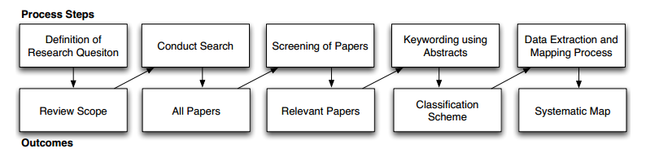
Systematic Mapping Process

Slide 25
Definition of Research Questions (Research Scope)
The main goal of a systematic mapping studies:
provide an overview of a research area, and
identify the quantity and type of research and results available within it.
Often one wants to map the frequencies of publication over time to see trends.
A secondary goal can be to identify the forums in which research in the area has been published.

Slide 26
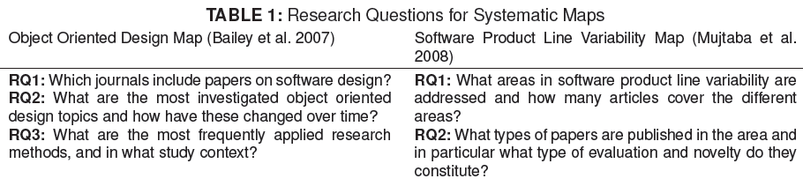
Definition of Research Questions (Research Scope)
These goals are reﬂected in both papers’ research questions (RQs) which are similar, as shown in Table 1.

Slide 27
Conduct Search for Primary Studies (All Papers)
The primary studies are identiﬁed by using search strings on scientiﬁc databases or browsing manually through relevant conference proceedings or journal publications.
A good way to create the search string is to structure them in terms of population, intervention, comparison, and outcome (Kitchenham & Charters 2007).
The structure should of course be driven by the research questions.
Keywords for the search string can be taken from each aspect of the structure.
E.g. outcome of a study (e.g., accuracy of an estimation method) could lead to keywords like ”case study” or ”experiment”, which are research approaches to determine this accuracy.

Slide 28
Example
Object Oriented Design Map: (”object oriented” AND ”design” AND ”empirical evidence”) OR (”OO” AND ”empirical” AND ”design”) OR (”software design” AND ”OO” AND ”experimental”)
Software Product Line Variability Map: ”software” AND (”product line” OR ”product family” OR ”system family”) AND (”variability” OR ”variation”)

Slide 29
Screening of Papers for Inclusion and Exclusion (Relevant Papers)
Inclusion and exclusion criteria are used to exclude studies that are not relevant to answer the research questions.
The criteria in Table 2 show that the research questions inﬂuenced the inclusion and exclusion criteria, thus the empirical part is considered only for the object oriented design map.

Slide 30
Example
Object Oriented Design Map (Bailey et al. 2007) | Software Product Line Variability Map (Mujtaba et al. 2008)
Inclusion: books, papers, technical reports and grey literature describing empirical studies regarding object oriented software design. Where several papers reported the same study, only the most recent was included. Where several studies were reported in the same paper, each relevant study was treated separately. | Inclusion: The abstract explicitly mentions variability or variation in the context of software product line engineering. From the abstract, the researcher is able to deduce that the focus of the paper contributes to product line variability research.
Exclusion: Studies that did not report empirical ﬁndings or literature that was only available in the form of abstracts or Powerpoint presentations. | Exclusion: The paper lies outside the software engineering domain. Variability and variation are not part of the contributions of the paper, the terms are only mentioned in the general introductory sentences of the Abstract.

Slide 31
Keywording of Abstracts (Classiﬁcation Scheme)
Keywording is a way to reduce the time needed in developing the classiﬁcaton scheme and ensuring that the scheme takes the existing studies into account.
Keywording is done in two steps :
First, the reviewers read abstracts and look for keywords and concepts that reﬂect the contribution of the paper.
While doing so, the reviewer also identiﬁes the context of the research.
When this is done, the set of keywords from different papers are combined together to develop a high level understanding about the nature and contribution of the research.
When a final set of keywords has been chosen, they can be clustered and used to form the categories for the map.

Slide 32
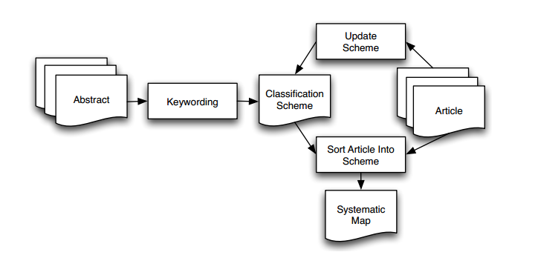
Building the Classification Scheme

Slide 33
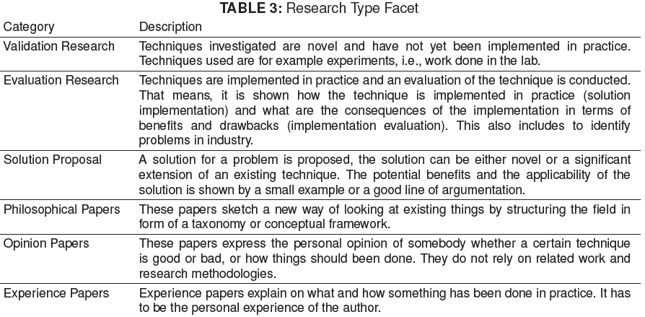
Classification of Research Approaches by Wieringa et al. 2006

Slide 34
Data Extraction and Mapping of Studies (Systematic Map)
When having the classiﬁcation scheme in place, the relevant articles are sorted into the scheme.
i.e., the actual data extraction takes place.
The classiﬁcation scheme evolves while doing the data extraction, like adding new categories or merging and splitting existing categories.

Slide 35
Data Extraction and Mapping of Studies (Systematic Map)
The analysis of the results focuses on presenting the frequencies of publications for each category.
This makes it possible to see which categories have been emphasized in past research, and thus, to identify gaps and possibilities for future research.
Bubble plot reports the frequencies of publication in each category.
This is basically two x-y scatterplots with bubbles in category intersections.
The size of a bubble is proportional to the number of articles that are in the pair of categories corresponding to the bubble coordinates.
E.g. Google’s Visualization Toolkit based on GapMinder could be used to create bubble plots that vary over time to better show research trends.

Slide 36
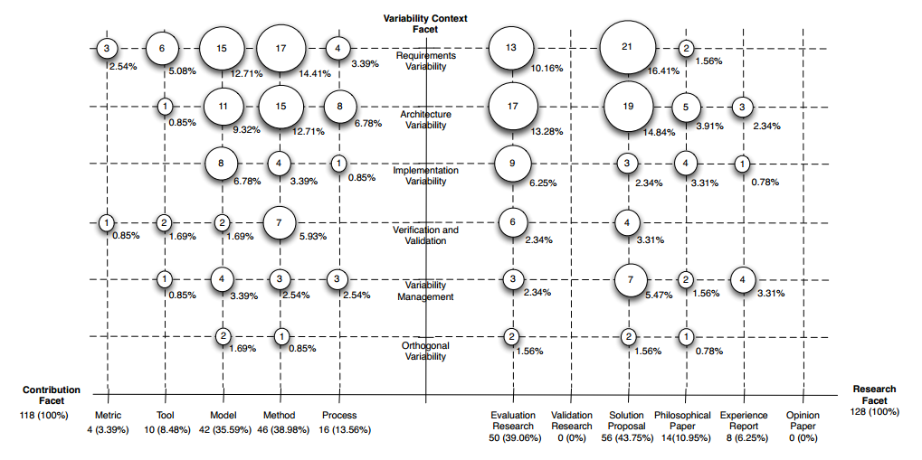
Visualization of a Systematic Map in the Form of a Bubble Plot

Slide 37
Outline
What is a Literature Review
Systematic Mapping Study
3. Systematic Literature Review
4. Difference between Systematic Mapping and Literature Review

Slide 38
Systematic Review
A systematic review is a literature review focused on a research question, trying to identify, appraise, select and synthesize all high quality research evidence and arguments relevant to that question [Wikipedia].
Systematic reviews aim to synthesise existing research
Fairly (without bias)
Rigorously (according to a defined procedure)
Openly (ensuring that the review procedure is visible to other researchers).
4 types of analysis:
Meta analysis: typically a systematic review using statistical methods to effectively combine the data used on all selected studies to produce a more reliable result [Wikipedia].
Comparative analysis: uses logical simplification and confidence assessment theories.
Thematic analysis: counts papers related to specific themes/categories.
Narrative summaries: focus on qualitative review and narrative explanations.

Slide 39
Systematic Review
Support Evidence-based paradigm
Step 1: Start from a well-defined question
Step 2: Define a repeatable strategy for searching the literature
Step 3: Critically assess relevant literature
Step 4: Synthesise literature (but only partially)

Slide 40
Advantages
Provide information about effects of a phenomenon across a wide range of settings.
Essential for fields of research that have sampling problems.
Consistent results provide evidence that phenomena are robust and transferable.
Inconsistent results
Allow sources of variation to be studied.
Meta-analysis possible for quantitative studies.

Slide 41
Disadvantages
Require more effort than informal reviews.
Difficult for lone researchers.
Standards require two researchers
Minimising individual bias

Slide 42
Anticipated Benefits
Create a firm foundation for future research.
Position your own research in the context of existing research
Close areas where no further research is necessary.
Uncover areas where research is necessary.
Help the development of new theories.
Identify common underlying trends
Identify explanations for conflicting results
Should be a standard research methodology.

Slide 43
Systematic Review Process
Develop Review Protocol
1) Plan Review
Validate Review Protocol
Identify Relevant Research
Select Primary Studies
2) Conduct Review
Assess Study Quality
Extract Required Data
Synthesise Data
Write Review Report
3) Document Review
Validate Report

Slide 44
1) Develop review protocol
Review protocol
Specifies methods to be used for a systematic review
Predefined protocol
Reduces researcher bias by reducing opportunity for
Selection of papers driven by researcher expectations
Changing the research question to fit the results of the searches
Good practice for any empirical study

Slide 45
Protocol Contents
Background
Rationale for survey
Research question
Critical to define this before starting the research
Strategy used to search for primary sources
Individual studies of the phenomenon of interest

Slide 46
Protocol Contents
Strategy to find primary studies
Search terms, resources, databases, journals, conferences
Procedures for storing references
How publication bias will be handled
How completeness will be determined
Selection Strategy
Inclusion/exclusion criteria

Slide 47
Protocol Contents
Quality assessment criteria
Criteria used to evaluate quality of primary sources
Data extraction
What data will be extracted from each primary source
How to handle missing information
How data reliability will be addressed
Usually multiple reviewers
Where data will be stored
Procedures for data synthesis
Formats for summarising data
Measures and analysis if meta-analysis is proposed
Should be tested during protocol construction

Slide 48
Research Question
Question structure (PICO)
Population, Problem, Patient (P)
People, projects types, applications types affected by the intervention
E.g. What are the issues related to the OO design problem?
Intervention, Prognostic Factor, Exposure (I)
Software method, tool, procedure
E.g. What are the main OO design methods being considered?
Comparison (C)
E.g. What is the main alternative to compare with an OO design method?
Outcomes (O)
Impact of technology in terms relevant to practitioners
Cost, quality, time to market
E.g. What are the cost measures used?

Slide 49
2) Conduct the Review
Enact the protocol
Expect further iterations of
Search strategy
Selection criteria
Data extraction
Record any deviations from the protocol
3) Document the Review
Using procedures defined in the protocol

Slide 50
Outline
What is a Literature Review
Systematic Mapping Study
Systematic Literature Review
4. Difference between Systematic Mapping and Literature Review

Slide 51
Differences between Systematic Review and Systematic Mapping
Difference in Goals
Systematic review : focus on identifying best practices based on empirical evidence.
Systematic mapping : focus on classiﬁcation, conducting thematic analysis and identifying publication fora.

Slide 52
Differences between Systematic Review and Systematic Mapping
Difference in Process
Systematic review : uses thematic analysis to see which categories are well covered in terms of number of publications.
Systematic mapping : the articles are not evaluated regarding their quality as the main goal is not to establish the state of evidence.

Slide 53
Differences between Systematic Review and Systematic Mapping
Difference in Breadth and Depth
Systematic review : state the outcome and quality assessment of the articles as a major focus, which increases the depth, and thus the effort required.
This could require a more speciﬁc focus of the study, and thus fewer studies being included.
Systematic mapping : more articles can be considered as they don’t have to be evaluated in such detail. Therefore, a larger ﬁeld can be structured (e.g., the whole software product line area).

Slide 54
Conclusion
The two types of studies can be considered as different points on a continuum.
A systematic map can be conducted first, to get an overview of the topic area.
Then the state of evidence in specific topics can be investigated using a systematic review.

Slide 55
References
Missy Harvey, What Is a Literature Review? http://www.cs.cmu.edu/~missy/WritingaLiteratureReview.doc
What can a literature review do for me? How to research, write, and survive a literature review (Stanford University). Available at: http://ual.stanford.edu/pdf/uar_literaturereviewhandout.pdf.
Tools for preparing literature reviews (George Washington University). Available at: http://www.gwu.edu/~litrev/.
The Literature review: A few tips on conducting it (University of Toronto). Available at: http://www.writing.utoronto.ca/advice/specific-types-of-writing/literature-review.
http://www.bcs.org/upload/pdf/ewic_ea08_paper8.pdf
http://www.scm.keele.ac.uk/ease/ease05_bk.ppt
http://www.cin.ufpe.br/~in1037/leitura/Kitchenham%202010%20-%20tertiary%20study.pdf
B. A. Kitchenham, “Procedures for Performing Systematic Reviews”, Keele University Technical Report EBSE-2007-01, 2007

